Slide 1

Life Prognosis System
A Life Expectancy Prognosis Tool
Nyunge-3

Slide 2

The Agenda
HIV epidemic in Sub-Saharan Africa
Our Solution to the epidemic
Benefits of our implementation
Conclusion

Slide 3
The HIV/AIDS Epidemic
“Sub-Saharan Africa accounted for 74% of HIV related deaths in 2013”.[1]

Slide 4
Why we should care
Weekly in 2023, 4,000 women (15–24) were newly infected with HIV worldwide, 3,100 in SSA. [3]
UNAIDS, 2024
Notes:
In sub-Saharan Africa, women and girls (all ages) accounted for 62% of all new HIV infections.

Slide 5

A personalized application would certainly Revolutionize HIV treatment in SSA

Slide 6

Project Demo

Slide 7
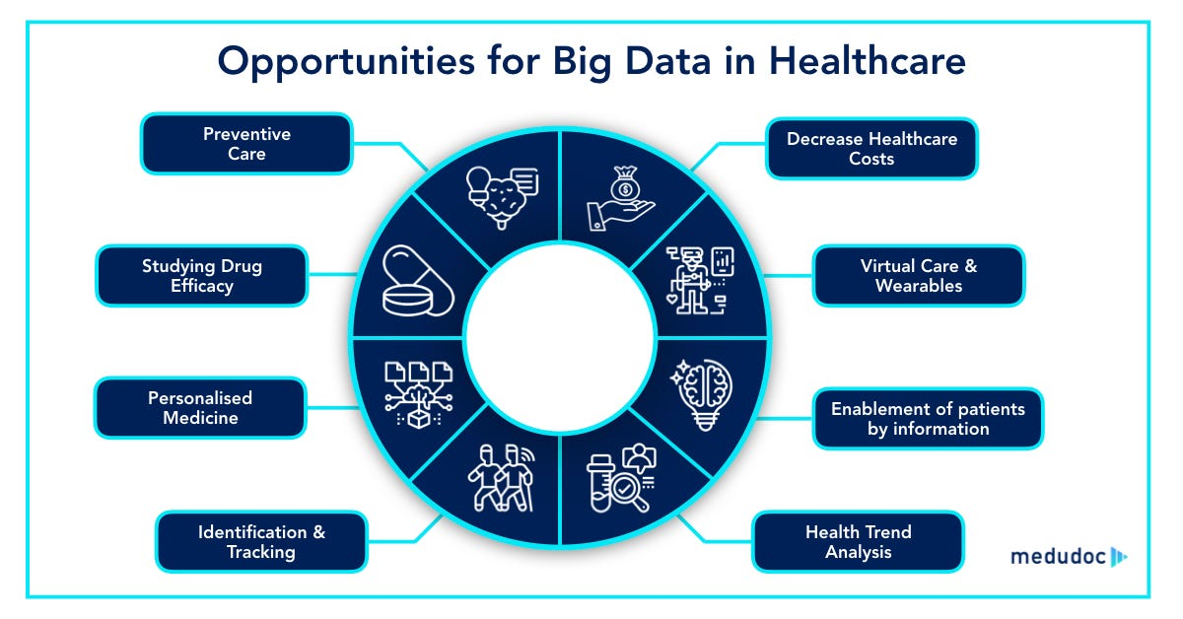
The benefits in HIV Health Care
With the amount of data we are collecting, the possibilities are endless.

Slide 8

Conclusion
We talked about:
HIV in sub-Saharan Africa
The project we are working on
Its potential to change HIV treatment in SSA
-

Slide 9

Thank you!
“Governments, donors, and health industry leaders must engage with these home-grown solutions to make health systems work effectively.”[4]

Slide 10

References
[1] A. B. M. Kharsany and Q. A. Karim, “HIV Infection and AIDS in Sub-Saharan Africa: Current Status, Challenges and Opportunities,” Open AIDS J., vol. 10, pp. 34–48, Apr. 2016, doi:10.2174/1874613601610010034.
[2] “Healthcare Data Analytics: Transforming Patient Care Through Insight.” Accessed: Aug. 13, 2024. [Online]. Available: https://innovatureinc.com/healthcare-data-analytics
[3] “Global HIV & AIDS statistics — Fact sheet.” Accessed: Aug. 14, 2024. [Online]. Available: https://www.unaids.org/en/resources/fact-sheet
[4] S. C. Keluo-Udeke, “Investing in African health tech can transform health systems,” World Economic Forum. Accessed: Aug. 07, 2024. [Online]. Available: https://www.weforum.org/agenda/2024/06/investing-in-african-health-tech-can-transform-health-systems/

